Slide 1


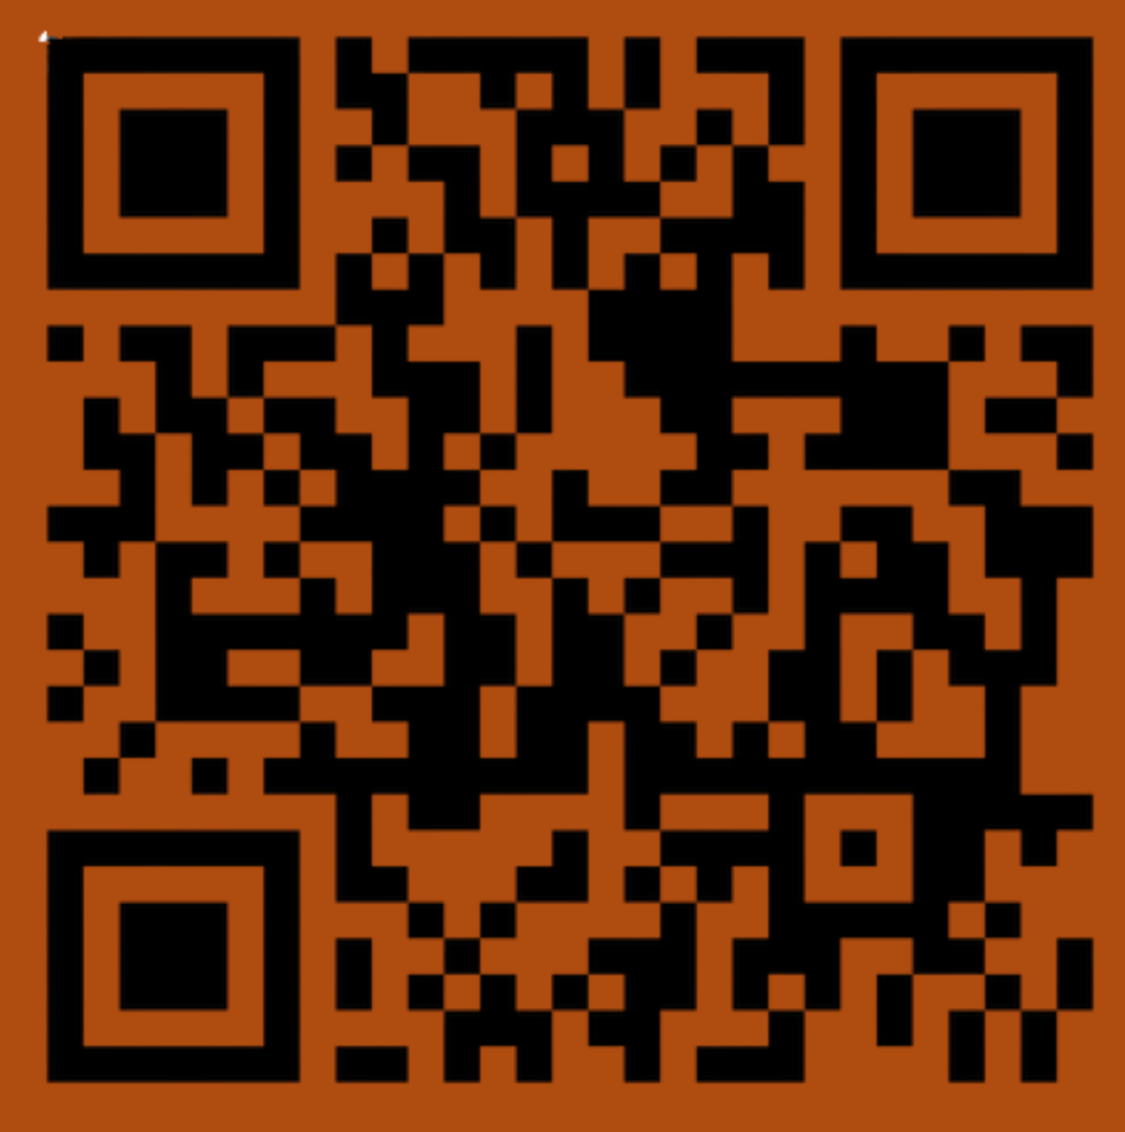

Slide 2
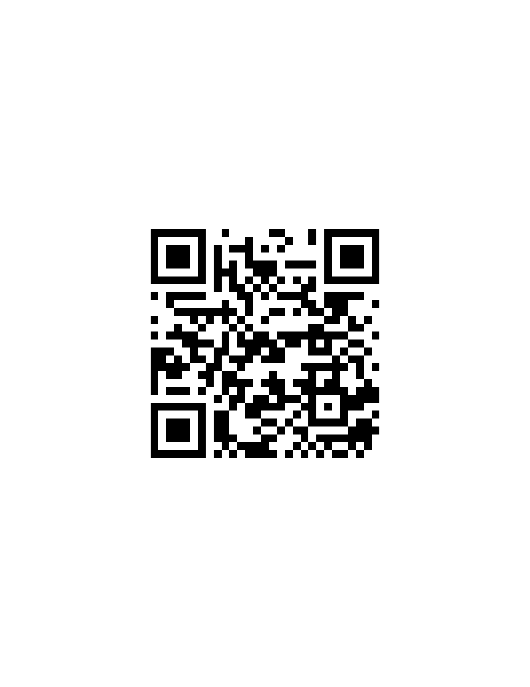
OPTIONAL SURVEY BUT WE’D LOVE YOU SO MUCH IF YOU’D DO THIS THANKYOUSOMUCH

Slide 3


Slide 4


Slide 5


Slide 6


Slide 7


Slide 8


Slide 9


Slide 10


Slide 11


Slide 12


Slide 13
If you’re getting extra credit: please come to the front to sign for your attendance!

